Slide 1
약물범죄 통계

Slide 2
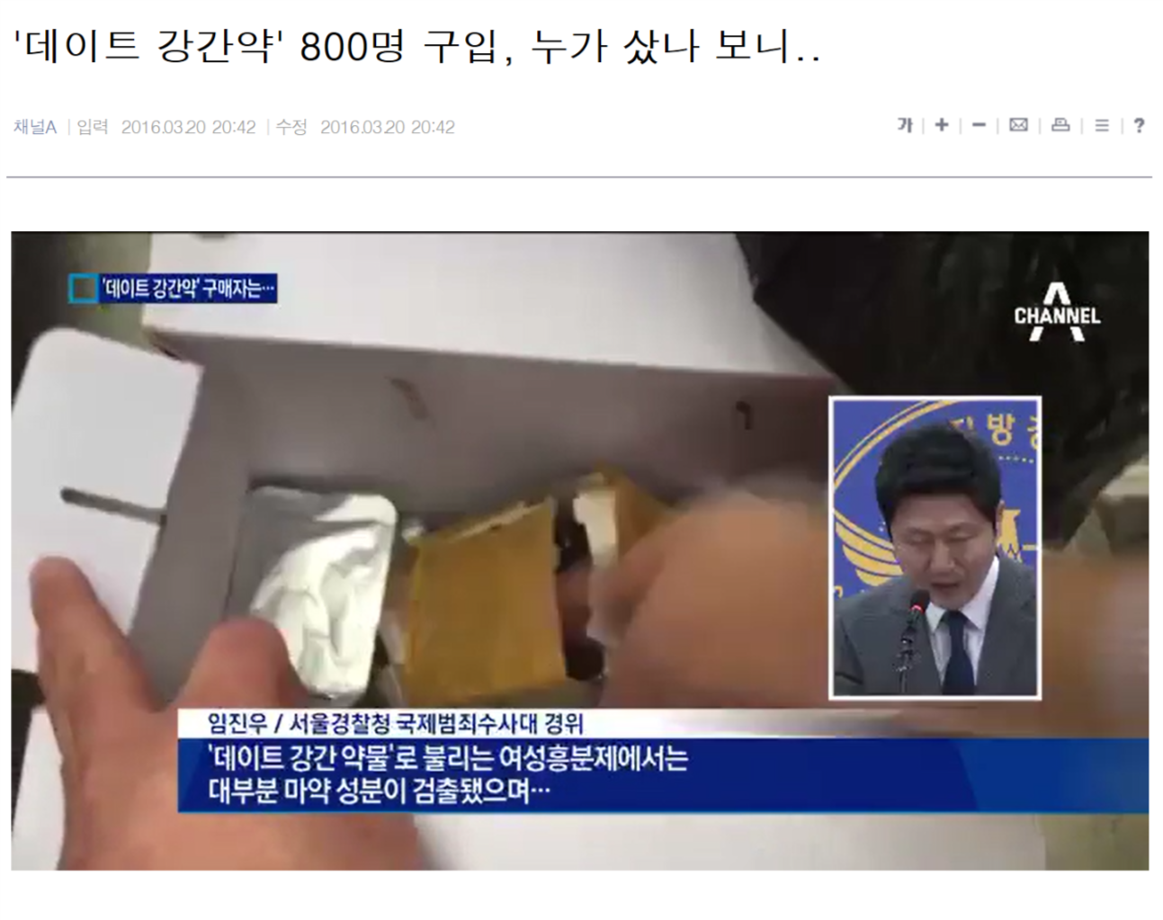
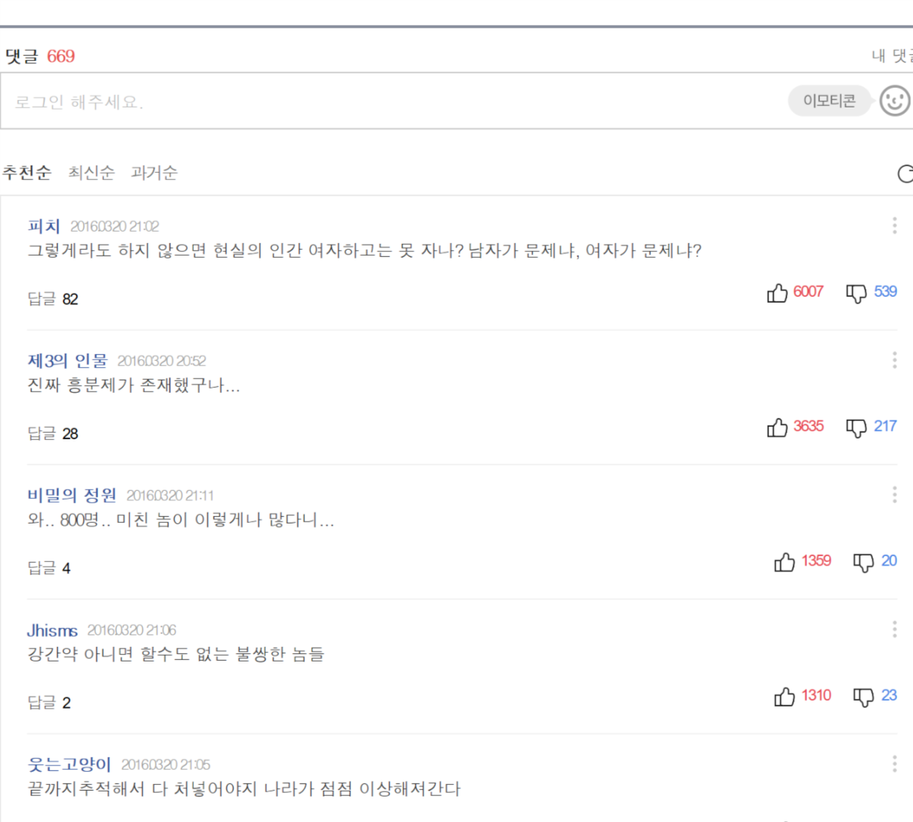
기사1-----------------------------------------------------------
출처
http://realestate.daum.net/news/detail/all/MD20160320204207161.daum

Slide 3
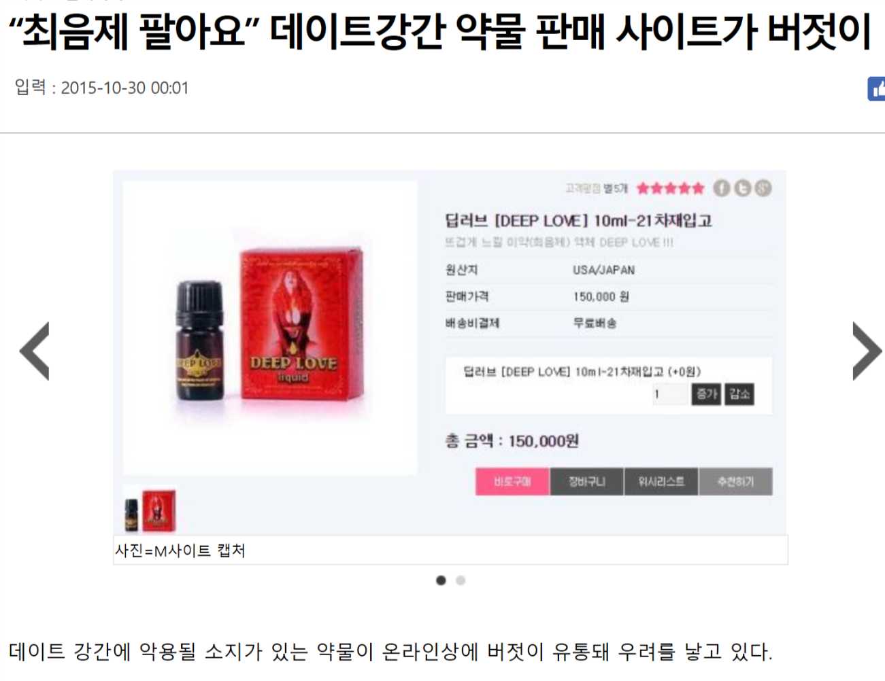
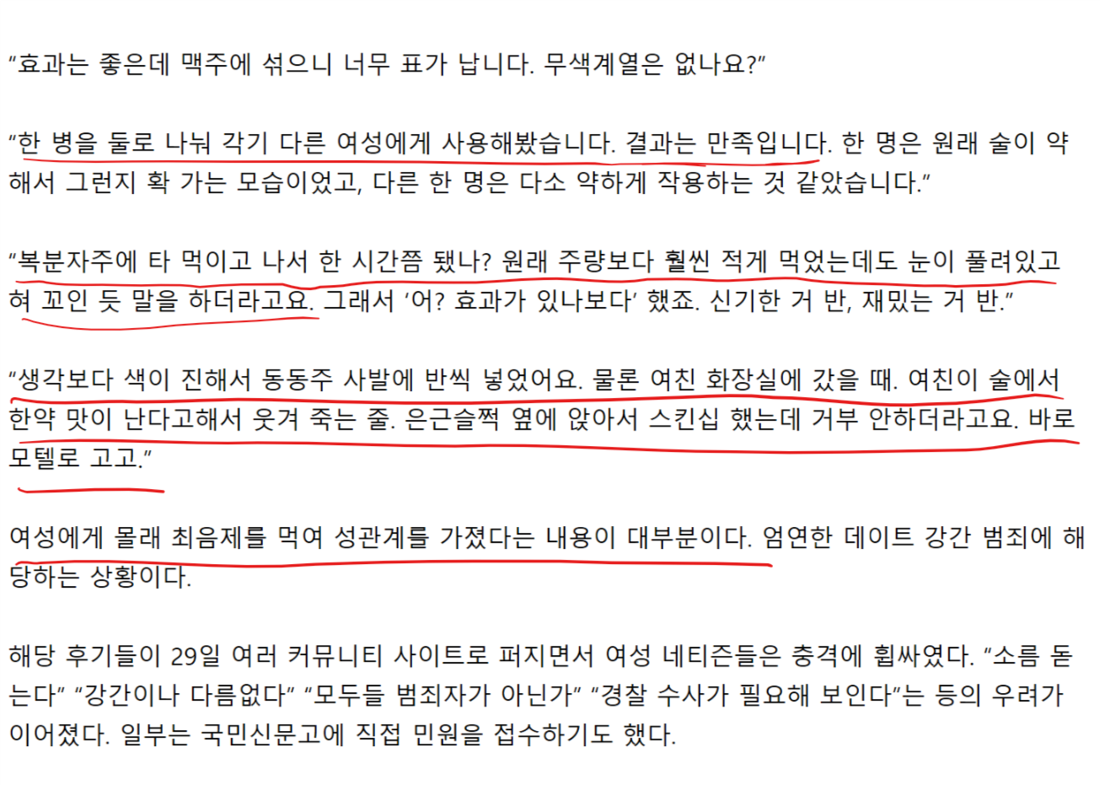
기사2------------------------------------------------------
출처
http://news.kmib.co.kr/article/view.asp?arcid=0010011155&code=61121111&cp=zu

Slide 4
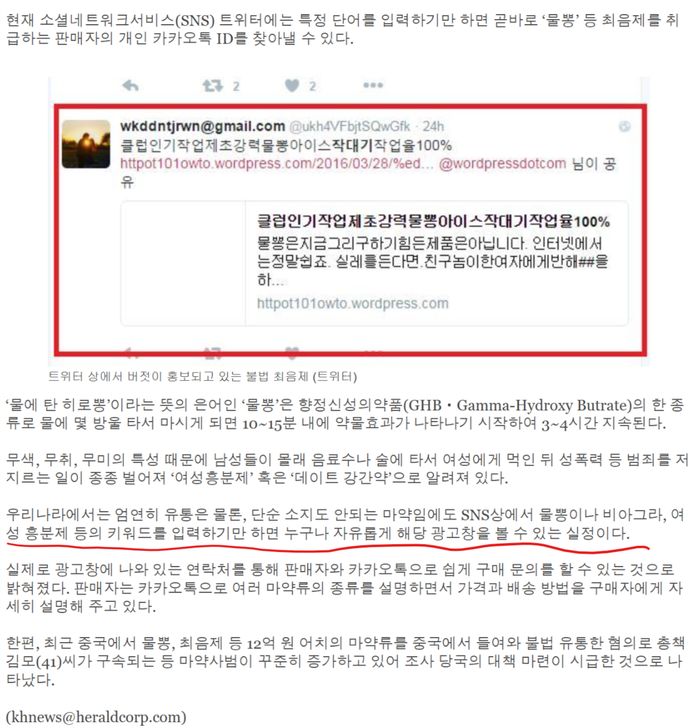
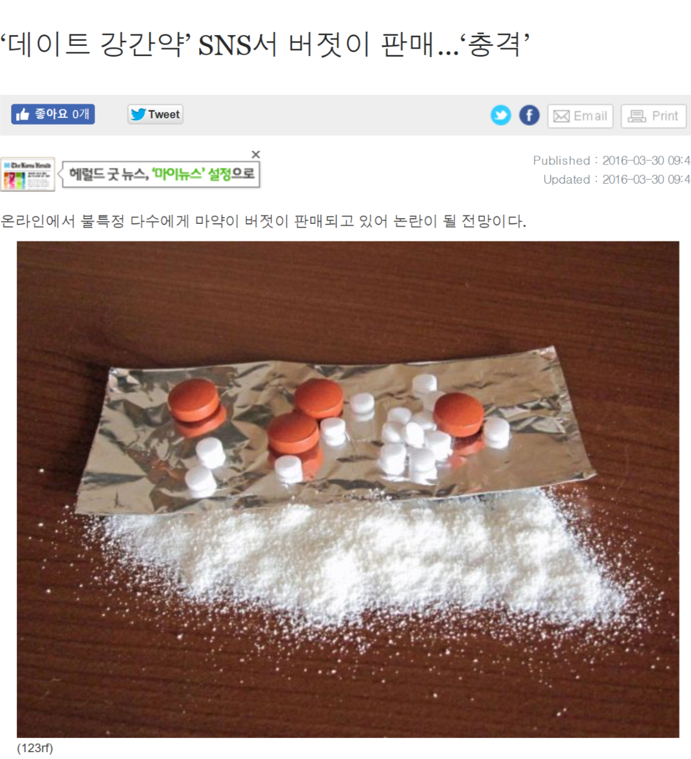
기사3------------
출처 : http://www.koreaherald.com/view.php?ud=20160329000814

Slide 5
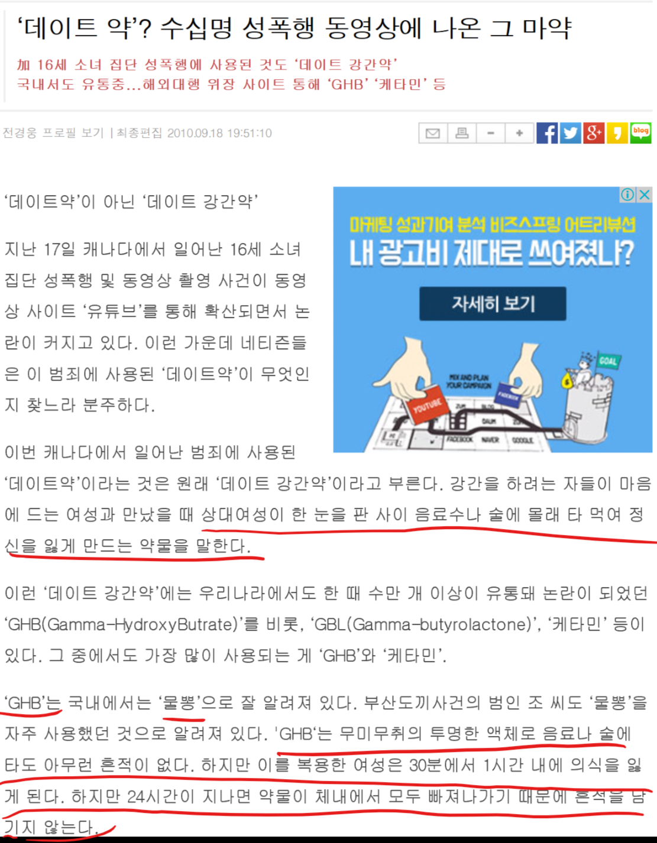
기사4 (해외)
출처 : https://newdaily.co.kr/news/article.html?no=56759

Slide 6
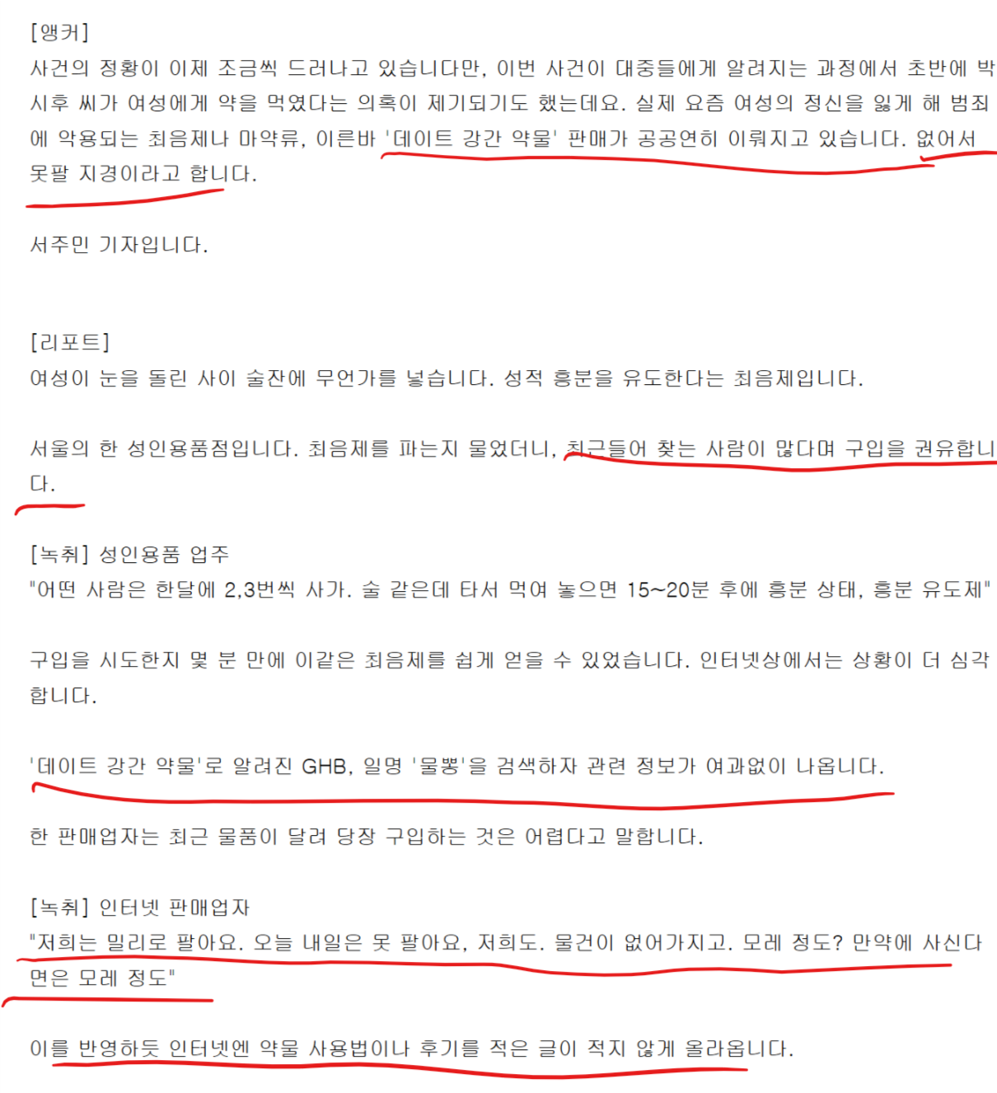
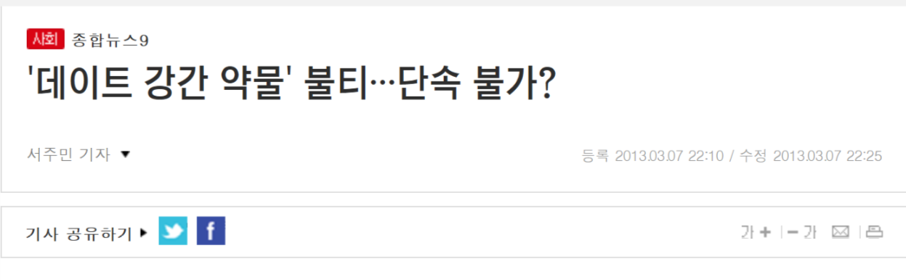
기사5---
유튜브: https://www.youtube.com/watch?v=G4a1zaa34Ac
출처 :http://news.tvchosun.com/site/data/html_dir/2013/03/07/2013030790149.html

Slide 7
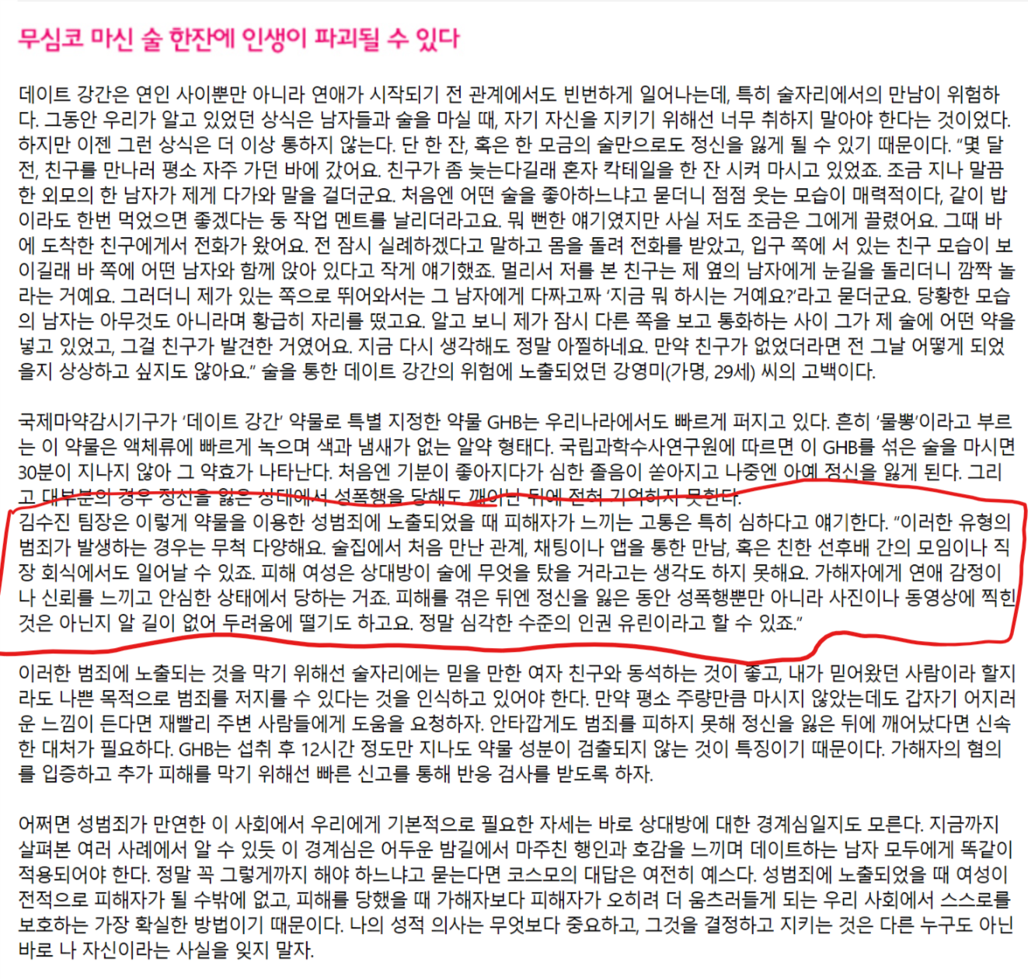
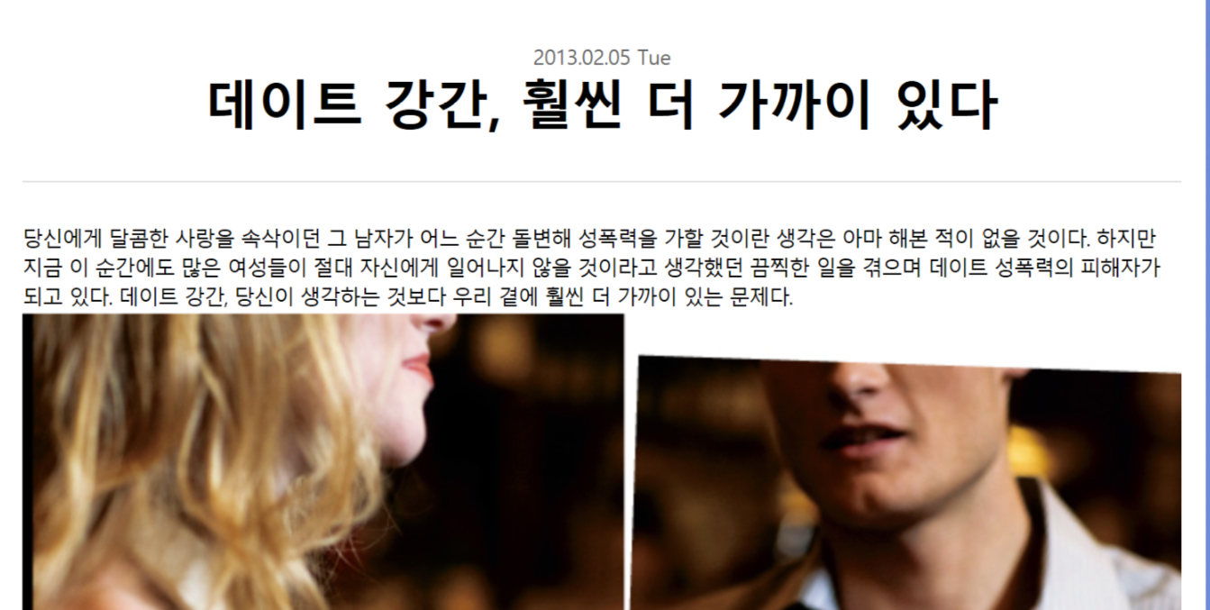
기사6---
출처 : http://www.cosmopolitan.co.kr/article/RetArticleView.asp?strArtclCd=A000001078&strFCateCd=ADAA

